Slide 1

Building My Proﬁle and a Calculator: A Journey Through HTML, CSS, and
JavaScript in My MLSA Internship

Slide 2






Introduction to My Journey
In this presentation, I will share my journey through building my proﬁle and a calculator during my MLSA internship. I will explore the essential technologies: HTML, CSS, and JavaScript, and how they contributed to my learning and development.

Slide 3




Understanding HTML Basics
HTML, or HyperText Markup Language, is the backbone of web development. It provides the structure for web pages. I learned to create semantic elements, which enhance accessibility and SEO, making my projects more effective and user-friendly.

Slide 4
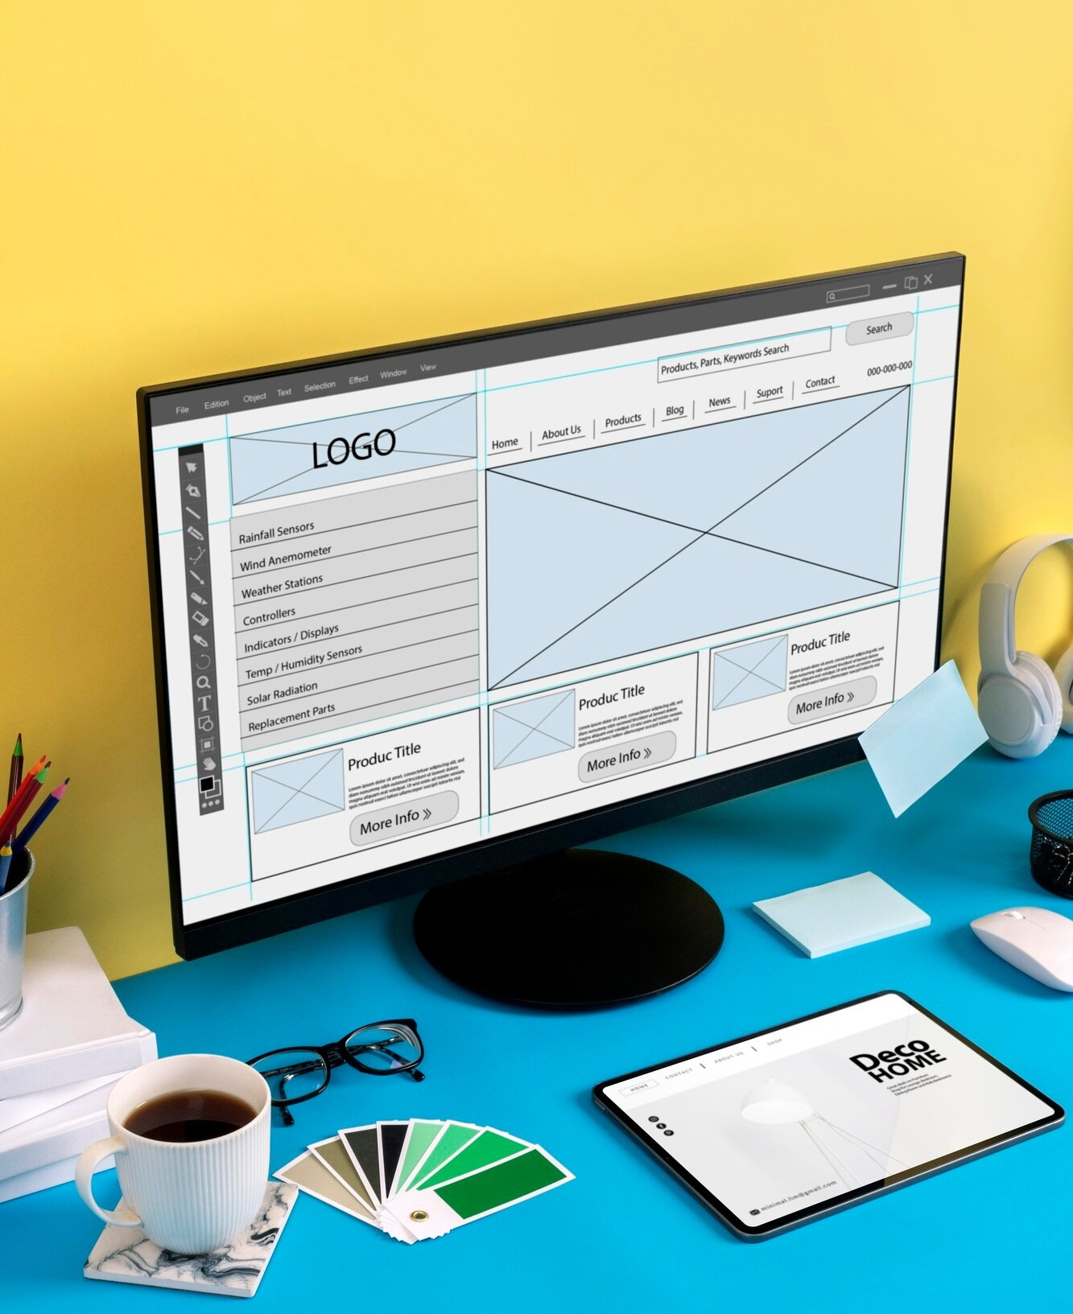



Styling with CSS
CSS, or Cascading Style Sheets, allows for the design and layout of web pages. I explored various styles, including colors, fonts, and responsive design techniques. This helped me create visually appealing and mobile-friendly interfaces.

Slide 5
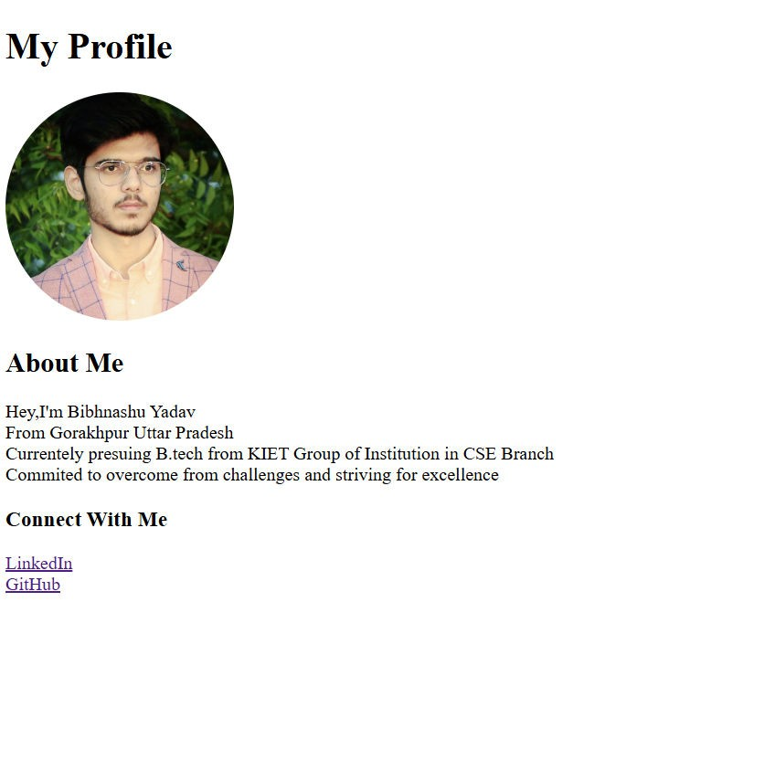
Project 1 : Personal Web Page
Objective :
Design simple yet effective web page
Component:
Introduction,Bio and Social Media Links

Slide 6
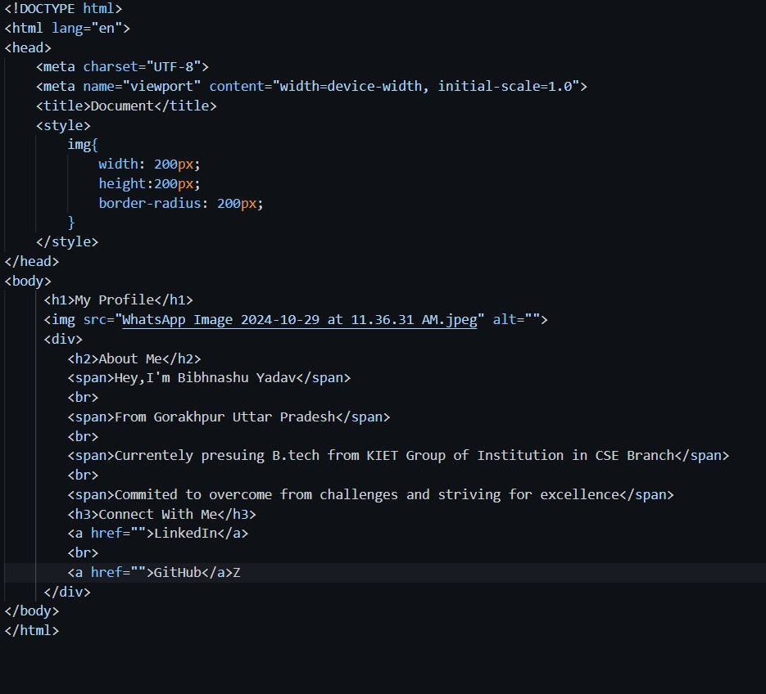
Project 1:Implementation
Html Structure:
Create a basic Html Structure with proﬁle image , About Me and Contect with me.
CSS styling:
Apply CSS to style page layouts like image size and it border radius

Slide 7


JavaScript for Interactivity
JavaScript is essential for adding interactivity to web pages. I learned how to manipulate the DOM and respond to user events. This knowledge was crucial for developing a functional calculator that enhances user experience.

Slide 8
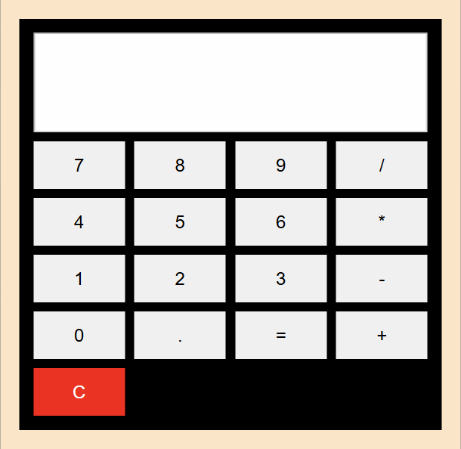
Project 2 :
Simple Calculator
Objective: To develop a fundamental calculator that carries out basic operations. The calculator will perform addition, subtraction, multiplication, and division, providing users with a simple interface for quick calculations. It aims to enhance accessibility for users of all ages and technical backgrounds.

Slide 9
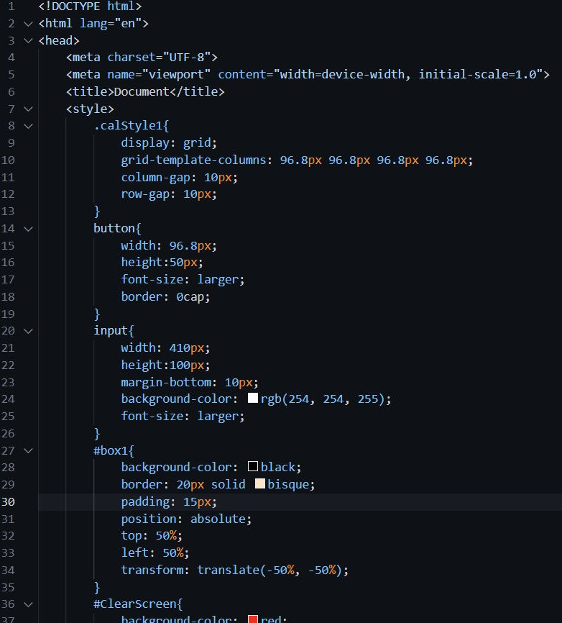
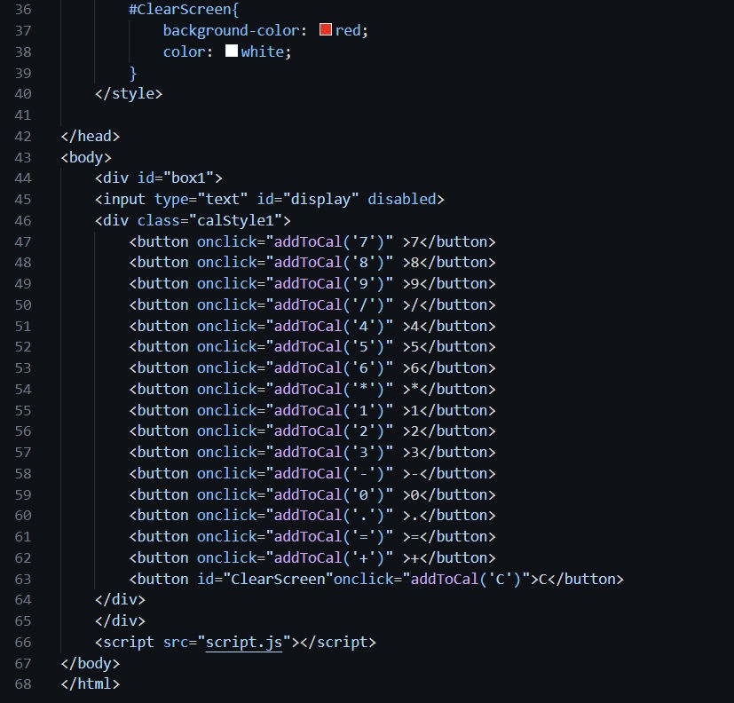
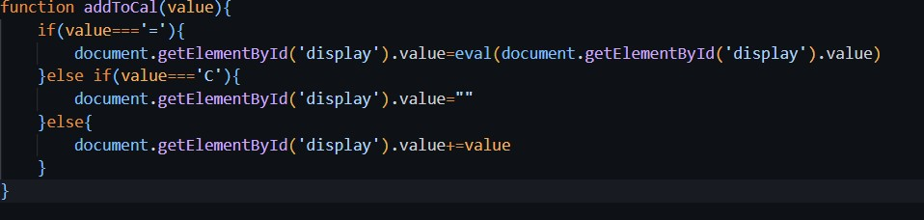
Project-2 Implementation: Html structure:
Create a basic Html structure using input ﬁeld and button for operatons.
CSS Styling:
Implement CSS to style button size , color ,font size
and layouts.
JavaScript:
Implememt JavaScript logic to handle button click and perform calculation

Slide 10




Conclusion and Future Steps
This internship has been a transformative experience, enhancing my skills in web development. I am excited to continue exploring HTML, CSS, and JavaScript and apply my knowledge to future projects, further developing my proﬁle in tech.

Slide 11
Thanks!
Name : Bibhanshu Yadav Branch: CSE
Roll No: 2300290100090

